Slide 1
Honeycrisp: Large-Scale Differentially Private Aggregation Without a Trusted Core
Edo Roth, Brett Hemenway Falk, Daniel Noble, Andreas Haeberlen

Slide 2
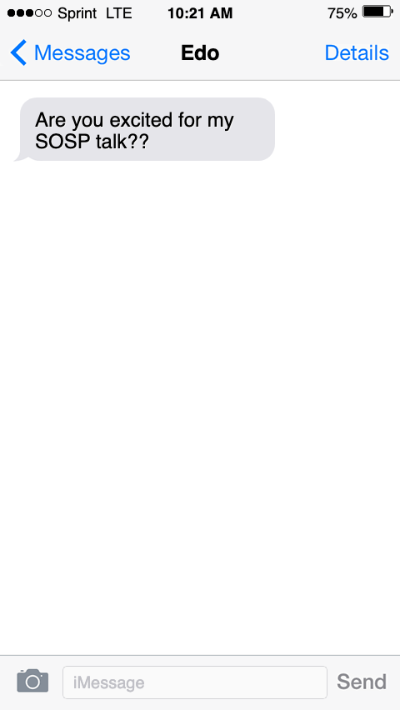

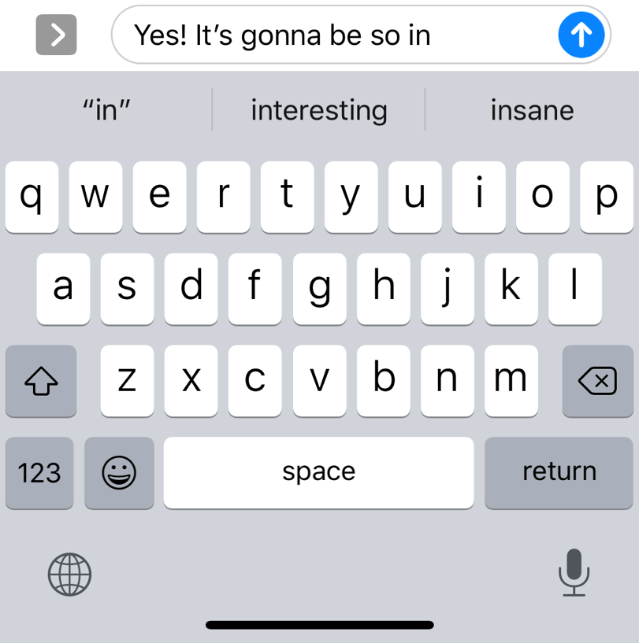
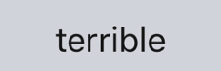
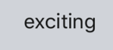
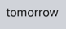
Collecting User Data
Modern phones have predictive typing features to suggest words based on context
Using models trained on user data

Slide 3

Collecting User Data
Modern phones have predictive typing features to suggest words based on context
Using models trained on user data
Raises privacy concerns
Aggregator
then | thanks
0.85 | 0.15
Privacy | Accuracy
😰 | 🤩
then | thanks
0.9 | 0.1
then | thanks
0.7 | 0.3
then | thanks
0.8 | 0.2
then | thanks
1.0 | 0.0

Slide 4
Collecting User Data (Privately)
Aggregator
For differential privacy, users add random noise
then | thanks
0.85 | 0.15
then | thanks
0.9 | 0.1
then | thanks
0.7 | 0.3
then | thanks
0.8 | 0.2
then | thanks
1.0 | 0.0

Slide 5

Collecting User Data (Privately)
Aggregator
then | thanks
0.73 | 0.127
For differential privacy, users add random noise
Introduces privacy/utility trade-off
Recommended to have a ‘privacy budget’ of 𝞮 = 1 for entirety of system run
Apple uses 𝞮 = 16
And renews this budget every day!
then | thanks
0.85 | 0.15
Privacy | Accuracy
🤩 | 😰
Privacy | Accuracy
😰 | 🤩
𝞮 = 3
𝞮 = 2
then | thanks
1.07 | 0.122
then | thanks
0.54 | 0.109
𝞮 = 1
𝞮 = 0.5
Privacy
Budget
𝞮 = 16
More privacy
Less accuracy
Less privacy
More accuracy
then | thanks
0.77 | 0.31
then | thanks
0.61 | -0.07

Slide 6
Honeycrisp: Best of Both Worlds
 | Privacy | Accuracy
Apple | 😰 | 🤩
Use ε=1 | 🤩 | 😰
Honeycrisp | 🤩 | 🤩

Slide 7
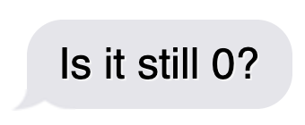
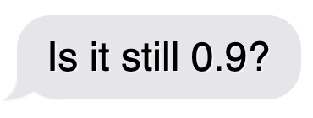
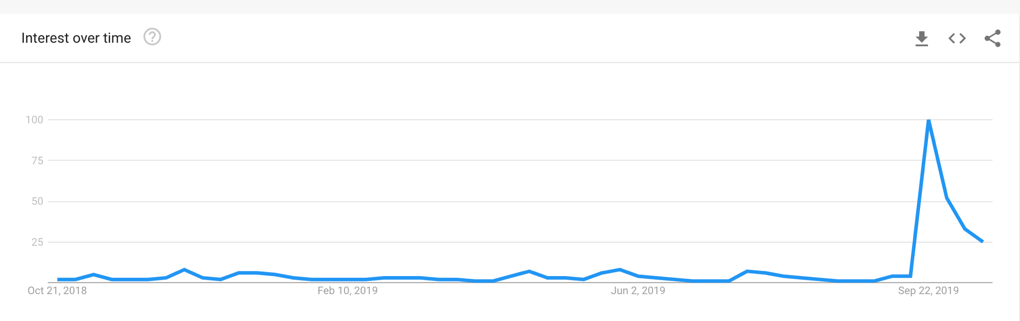

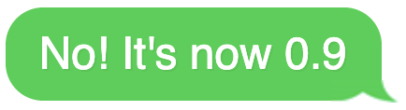

Idea 1: Use Sparse Vector Theorem
Word distributions don’t change very frequently!
(e.g., frequency of word ‘impeachment’ in Google search)
We don’t see any real ’privacy loss’ unless the data changes
Sparse Vector Theorem (SVT) lets us ‘guess’ using previous answers!
…
Oct 21, 2018
Feb 10, 2019
Jun 2, 2019
Sep 22, 2019

Slide 8

Idea 2: Aggregate Encrypted Data
Aggregator
then | thanks
0.85 | 0.15
Use homomorphic encryption so aggregator never sees data
Introduce mechanism to take encrypted value and reveal it to aggregator only when result is different (SVT)
Leverages huge aggregator resources
then | thanks
0.9 | 0.1
then | thanks
0.7 | 0.3
then | thanks
0.8 | 0.2
then | thanks
1.0 | 0.0

Slide 9




Honeycrisp
Randomly chosen committee:
Generates keypair
Shards secret key
Distributes (signed) public key to all devices
Data is encrypted
Aggregator sums up all ciphertexts homomorphically
Aggregator communicates encrypted sum and guess
Inside an MPC, committee:
Adds noise to the sum
Decrypts
Releases final answer IF the guess is not close
Σ
Aggregator
Guess,
Σ
Response
Privacy | Accuracy
🤩 | 🤩
Secret
…
Public
0.9
0.7
0.8
1.0

Slide 10
Rest of Talk Outline
Overview
Collecting User Data
... with Differential Privacy
Two Key Ideas
Honeycrisp Design
Technical details
Threat Model and Goals
Distributing the Key Pair
Proving Ciphertext Inclusion
Formal Guarantees
Evaluation
Privacy Budget
Can Honeycrisp scale?

Slide 11
Threat Model and Goals
Threat model:
Aggregator can be occasionally Byzantine
For short periods of time, not at the beginning
Users are mostly correct
A small fraction of the users (~1-5%) can be Byzantine
Goals:
Accuracy: Aggregator learns the answer to their query (with very little noise)
Privacy: Aggregator cannot learn data of individual users

Slide 12
Distributing the Key Pair
Users encrypt with a public key
Who holds secret key?
Can’t rely on aggregator
Don’t want to use additional party
Idea: distribute among devices
Use a sortition method to generate dynamic committee of devices
Secret key is jointly held, but no individual party knows it
Public key is signed by committee and distributed to all devices
(small)MPC
Secret
Public
Public

Slide 13
Enforcing Ciphertext Inclusion
Two challenges:
1) Users could input bad data
2) Aggregator doesn’t sum up data correctly, to target specific individuals
– must submit ZK range proof

Slide 14
Enforcing Ciphertext Inclusion
Two challenges:
1) Users could input bad data
2) Aggregator doesn’t sum up data correctly, to target specific individuals

Slide 15

Enforcing Ciphertext Inclusion
Aggregator
the | thanks
0.85 | 0.15
Aggregator doesn’t sum up data correctly, to target specific individuals
Could multiply one data point by large factor
then | thanks
0.9 | 0.1
then | thanks
0.7 | 0.3
1000 x
then | thanks
0.8 | 0.2
then | thanks
1.0 | 0.0

Slide 16
Enforcing Ciphertext Inclusion
Aggregator
the | thanks
0.85 | 0.15
Aggregator doesn’t sum up data correctly, to target specific individuals
Could multiply one data point by large factor
then | thanks
900 | 100
then | thanks
0.7 | 0.3
then | thanks
0.8 | 0.2
then | thanks
1.0 | 0.0

Slide 17
Enforcing Ciphertext Inclusion
Aggregator
the | thanks
901.5 | 100.5
Aggregator doesn’t sum up data correctly, to target specific individuals
Could multiply one data point by large factor
then | thanks
900 | 100
then | thanks
0.7 | 0.3
then | thanks
0.8 | 0.2
then | thanks
1.0 | 0.0

Slide 18
Enforcing Ciphertext Inclusion
Aggregator
the | thanks
901.5 | 100.5
Aggregator doesn’t sum up data correctly, to target specific individuals
Could multiply one data point by large factor
Because of differential privacy, added noise may no longer obscure this!
then | thanks
900 | 100
then | thanks
0.7 | 0.3
then | thanks
0.8 | 0.2
then | thanks
1.0 | 0.0

Slide 19

Enforcing Ciphertext Inclusion
Aggregator doesn’t sum up data correctly, to target specific individuals
Could multiply one data point by large factor
Because of differential privacy, added noise may no longer obscure this!
To solve this, Honeycrisp requires:
the summation is checked
Devices randomly select triples of nodes (parent + children) to enforce correctness
2.7
1.6
0.9
0.7
1.1
0.1
1.0
Summation Tree
Root node: total sum
Leaf nodes: individual data points
All values encrypted

Slide 20
Enforcing Ciphertext Inclusion
Ensure that Aggregator computes summation correctly
Could try to identify single user’s data
Because of differential privacy, added noise may no longer obscure this!
To solve this, Honeycrisp requires:
the summation is checked.
Devices randomly select triples of nodes (parent + children) to enforce correctness
When alarm is sounded, protocol stops to avoid access of private data
901.1
900
0.9
0.7
1.1
0.1
1.0
Summation Tree
Root node: total sum
Leaf nodes: individual data points
All values encrypted

Slide 21
Formal Guarantees
Privacy: No user’s data is learned in the clear by the Aggregator or any other user
Correctness: Aggregator receives correct responses to their queries (modulo the noise required for differential privacy.)
Liveness: As long as some privacy budget remains, the Aggregator can continue to query the system and receive responses
Indemnification: Devices cannot fabricate any evidence showing that the Aggregator performed maliciously
Proofs in the paper (tech report)
← Not satisfied when aggregator is malicious

Slide 22
Rest of Talk Outline
Overview
Collecting User Data
... with Differential Privacy
Two Key Ideas
Honeycrisp Design
Technical details
Threat Model and Goals
Distributing the Key Pair
Proving Ciphertext Inclusion
Formal Guarantees
Evaluation
Privacy Budget
Can Honeycrisp scale?

Slide 23
Evaluation
Can Honeycrisp support periodic queries while giving reasonable privacy guarantees?
Privacy budget utility;
Probability of privacy failure for various committee sizes;
Minimum committee size needed for liveness.
How expensive is Honeycrisp in terms of computation, bandwidth, and storage?
Bandwidth and computation for each participant in each round
Bandwidth and time of two MPC steps for committee members using SCALE-MAMBA
Bandwidth, computation and storage required of aggregator
How well does Honeycrisp scale?
Different user base sizes from 130 million to 13 billion
Different committee sizes from 10 to 40

Slide 24
Evaluation
Can Honeycrisp support periodic queries while giving reasonable privacy guarantees?
Privacy budget utility;
Probability of privacy failure for various committee sizes;
Minimum committee size needed for liveness.
How expensive is Honeycrisp in terms of computation, bandwidth, and storage?
Bandwidth and computation for each participant in each round
Bandwidth and time of two MPC steps for committee members using SCALE-MAMBA
Bandwidth, computation and storage required of aggregator
How well does Honeycrisp scale?
Different user base sizes from 130 million to 13 billion
Different committee sizes from 10 to 40

Slide 25
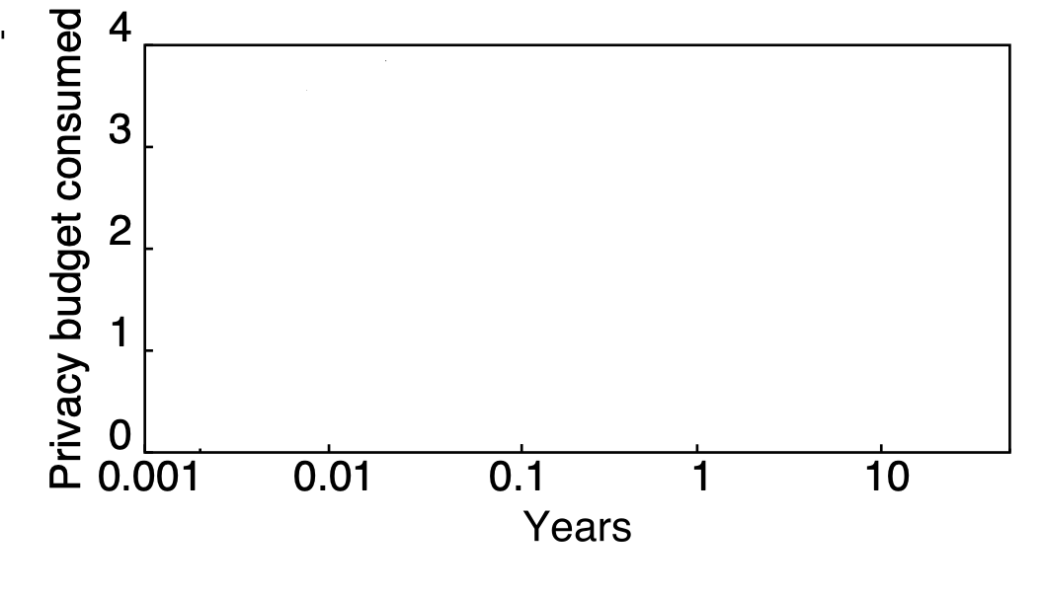
Privacy Budget Utility
Experiment: word frequency data from Twitter

Slide 26
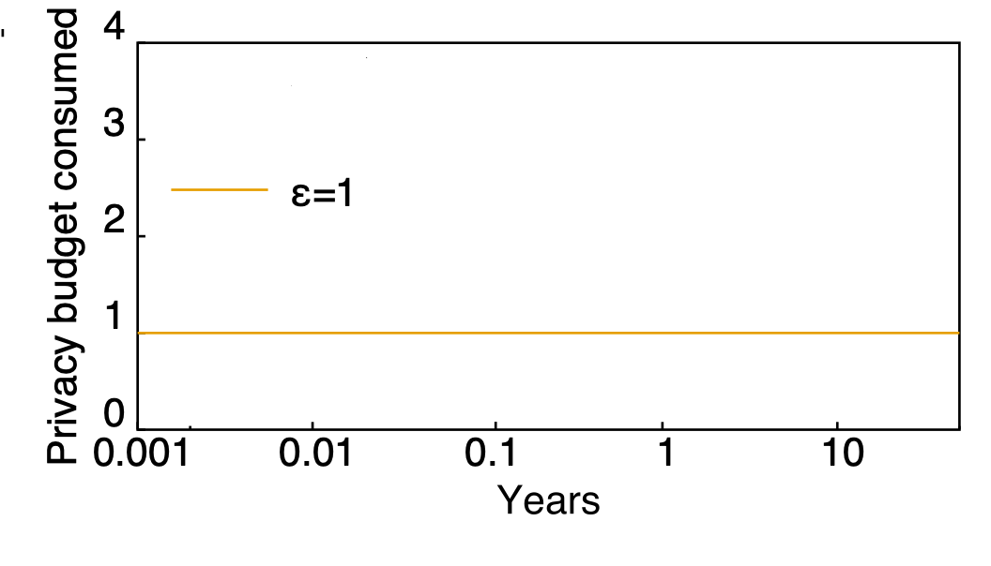
Privacy Budget Utility
Experiment: word frequency data from Twitter
Commonly Recommended

Slide 27
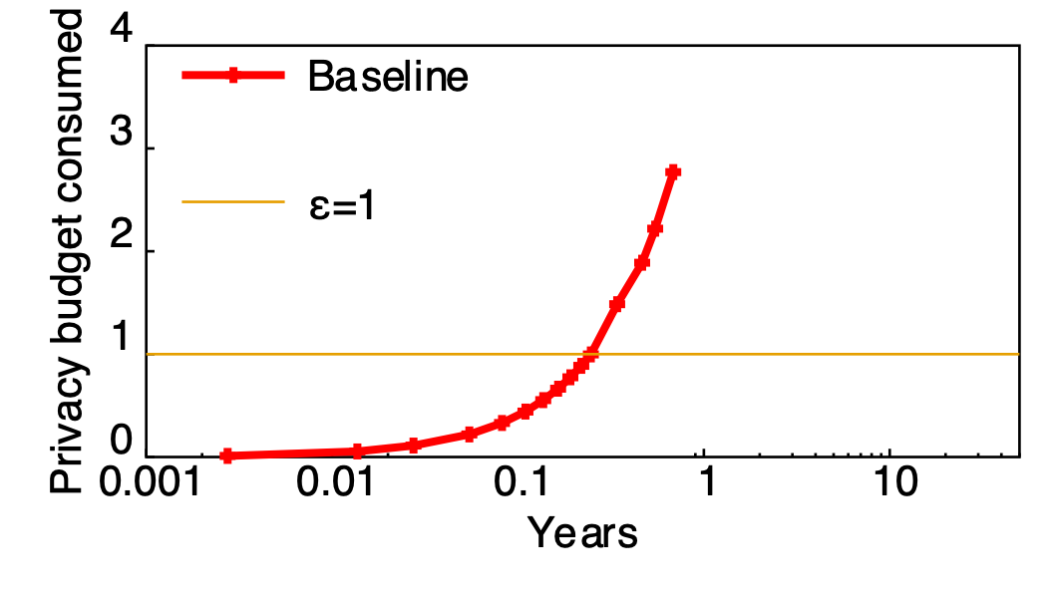
Privacy Budget Utility
Experiment: word frequency data from Twitter
91 days

Slide 28
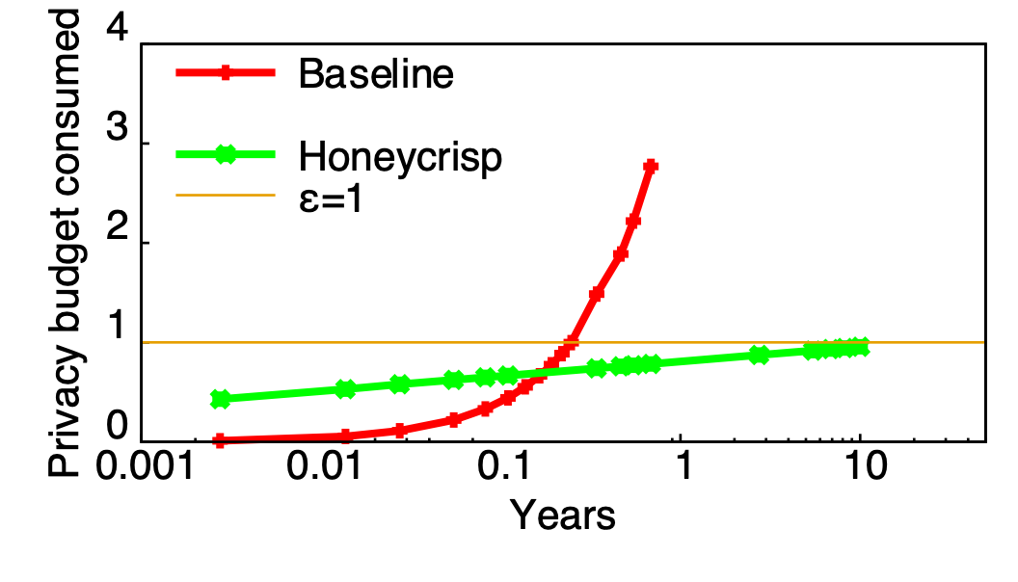
Privacy Budget Utility
Experiment: word frequency data from Twitter
91 days vs. 10 years!
91 days
10 years

Slide 29
Can Honeycrisp scale?
Per-participant
Can it handle 1.3 billion devices?
Experiment: summation tree verification with ciphertexts, estimation of range proofs
What we found:
Scales to billions
Cheap (and near-constant) for users
Committee members must do more
Most of the heavy lifting is done by the aggregator
Estimated # of Apple Devices

Slide 30
Summary
Distributed analytics is hard!
Difficult tradeoff between privacy and accuracy
Current deployments heavily favor accuracy
Our contribution: Honeycrisp
Uses the sparse vector technique
Homomorphic encryption + secret sharing
Result: Strong privacy and good accuracy!
Daily queries for up to 10 years, with ε=1
Scales to billions of devices
Questions?

